Slide 1
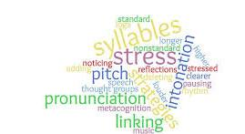
Stress and Intonation

Slide 2
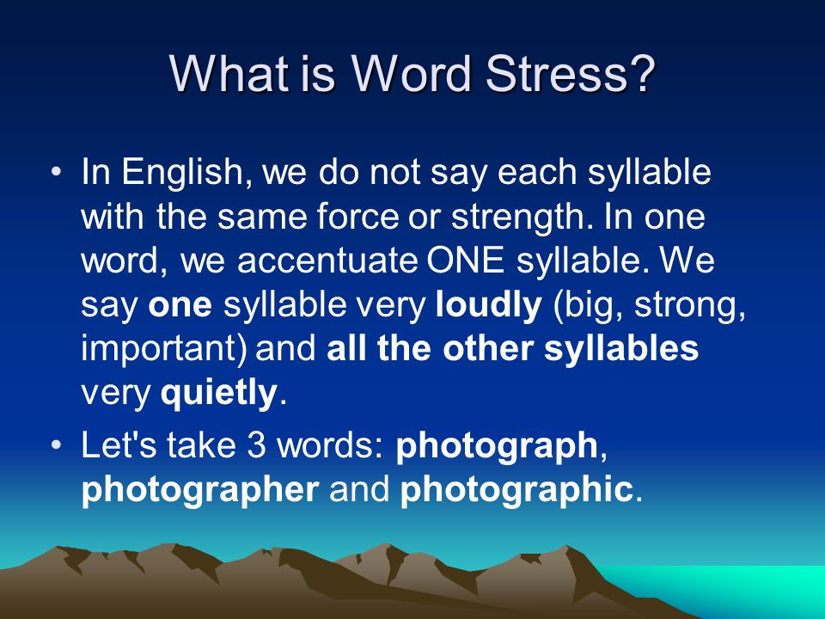

Slide 3
Syllables
Syllables are sound units that build up the structure of every word. They are a very important part of speech.
They give a word its pronunciation.
Without them speech would sound dull, boring and meaningless.

Slide 4

Syllables
Syllable is a unit of pronunciation having one vowel sound, with or without surrounding consonants, forming the whole or a part of a word; for example, there are two syllables in water and three in inferno.
Syllable Stress is very important to understand as using stress on the wrong syllable can affect our pronunciation.

Slide 5
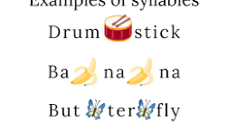
Examples

Slide 6


Ways to count syllable
2. Write a word down on a piece of Paper.
1. Clap your hands as you say a word.

Slide 7
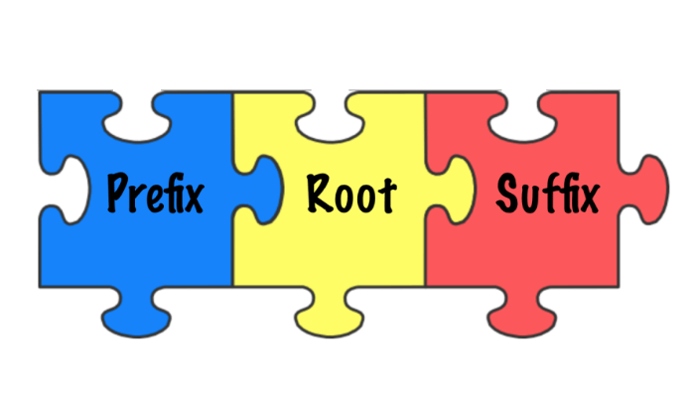
Ways to count syllable
3. Identify any prefix in a word
4. Identify any sufix in a word
Painfull
Fearless
Dishonest
Remove

Slide 8
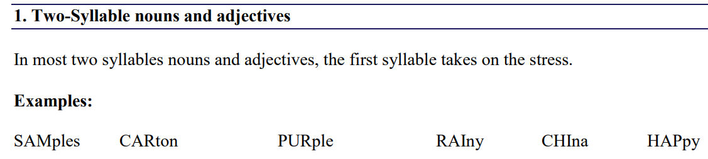

Slide 9
2. Two-Syllable verbs and prepositions
In most two syllables verbs and prepositions, the stress is on the second syllable.
Examples:
reLAX
aSIDE
betWEEN
diRECT
deCIDE
aMONG

Slide 10
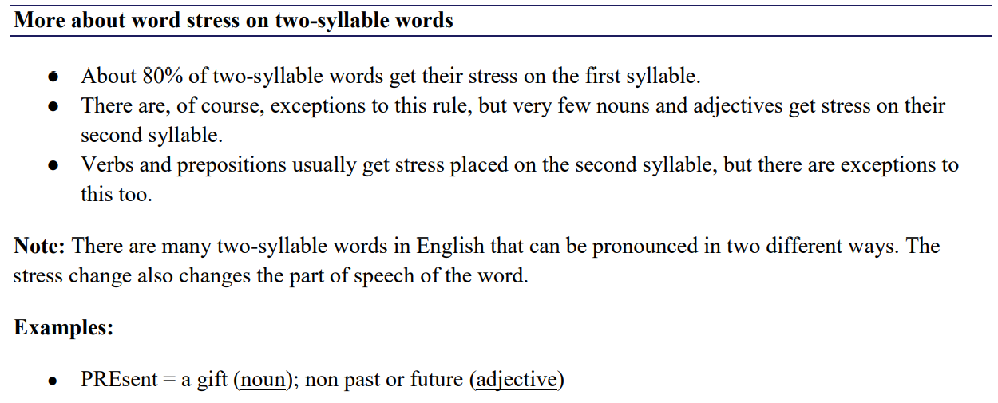

Slide 11
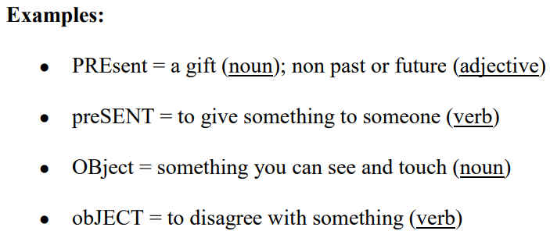

Slide 12

Three-Syllable words
For three-syllable words, word stress in on 2nd syllable most of the times. However, exceptions are always there.
adEquate amAzement attEntion attrActive banAna

Slide 13
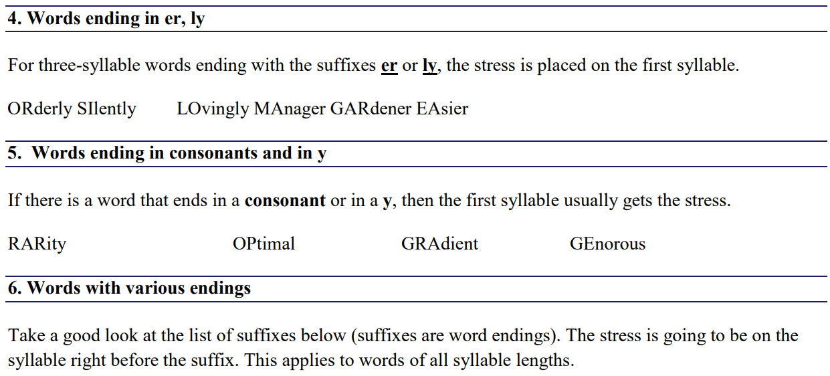

Slide 14
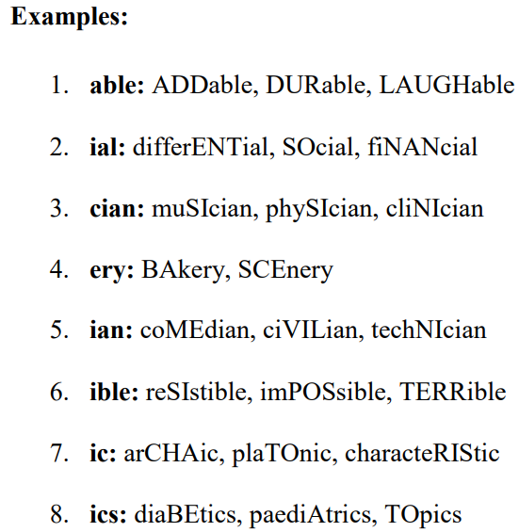
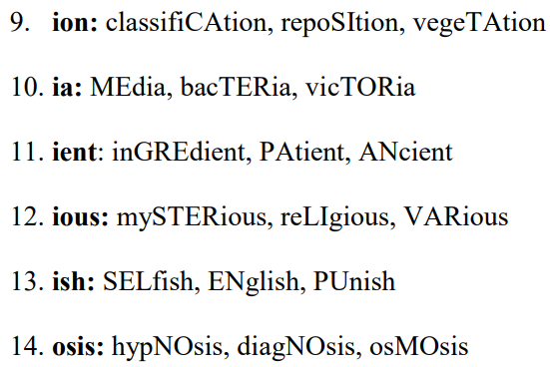

Slide 15
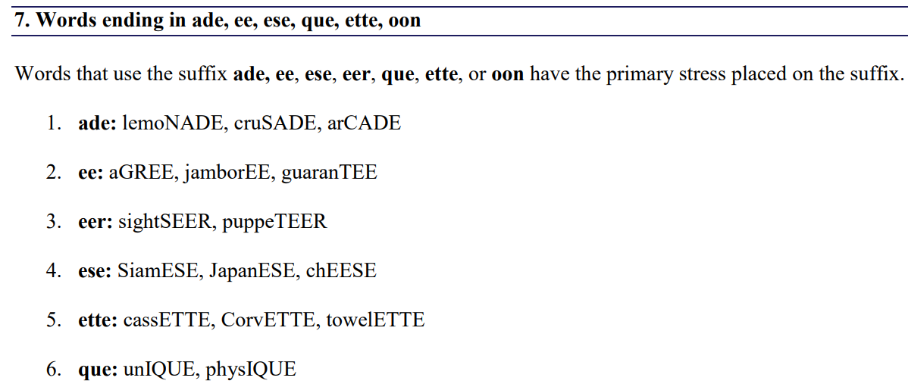


Slide 16
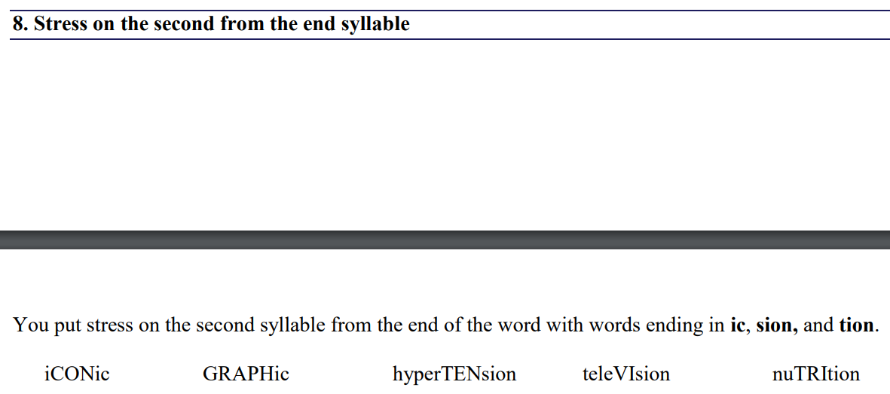

Slide 17
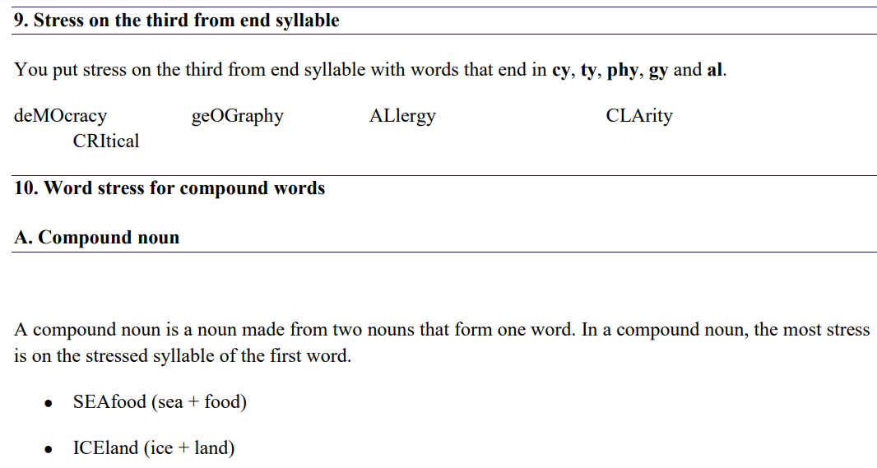

Slide 18
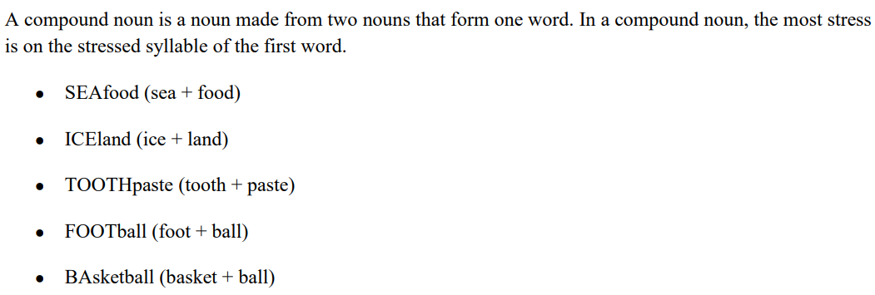

Slide 19
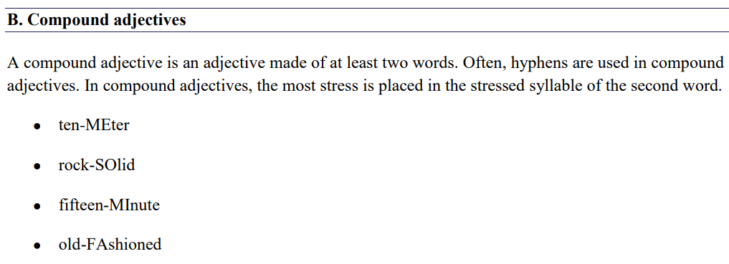

Slide 20
C. Compound verbs
A compound verb is when a subject has two or more verbs. The stress is on the second or on the last part.
Matilda loves bread but deTESTS butter.
Sarah baked cookies and ATE them up.
Dogs love to eat bones and love to DRINK water

Slide 21
D. Noun + compound nouns
Noun + compound Nouns are two-word compound nouns. In noun + compound noun, the stress is on the first word.
AIRplane mechanic
PROject manager
BOARD member

Slide 22
Reflexive pronouns
Reflexive pronouns show that the action affects the person who performs the action.
For example:
I hit mySELF.
The second syllable usually takes the stress.
● mySELF ● themSELVES ● ourSELVES

Slide 23
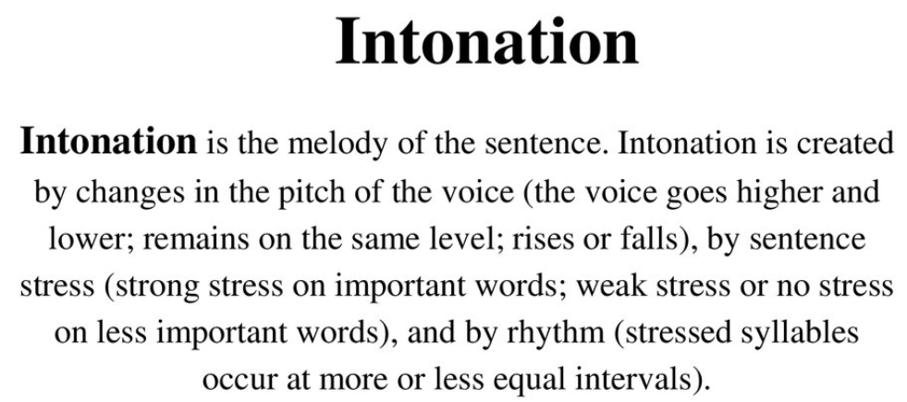

Slide 24
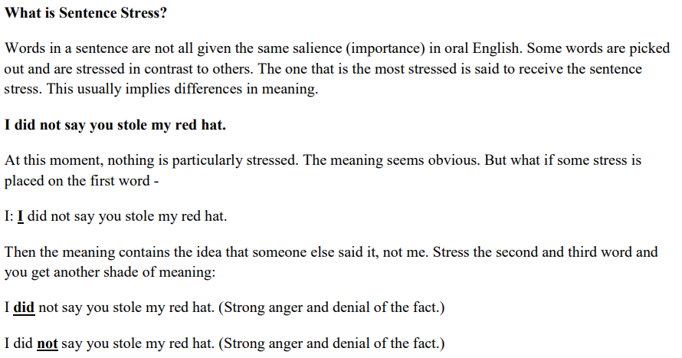

Slide 25
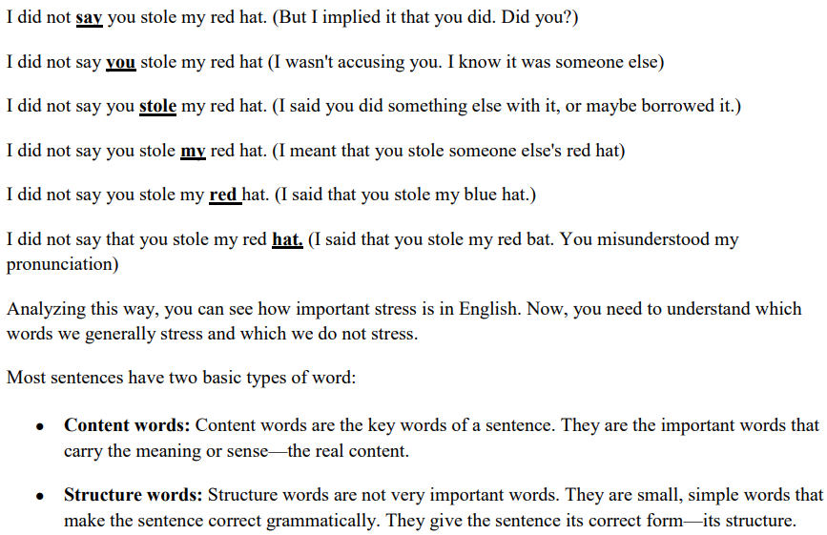

Slide 26
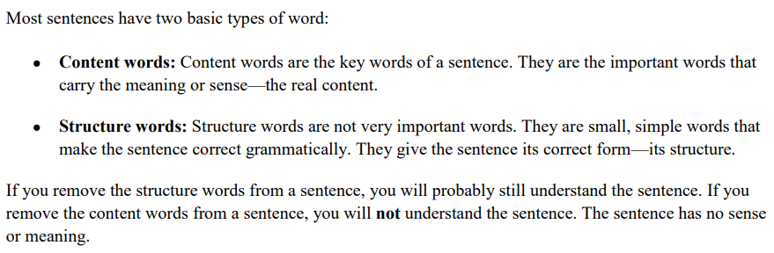

Slide 27
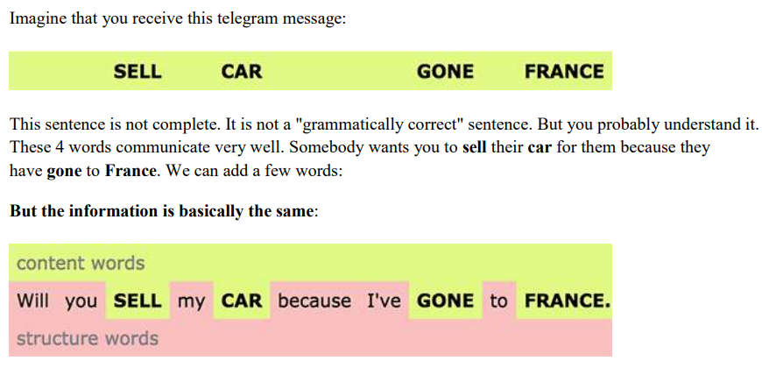

Slide 28
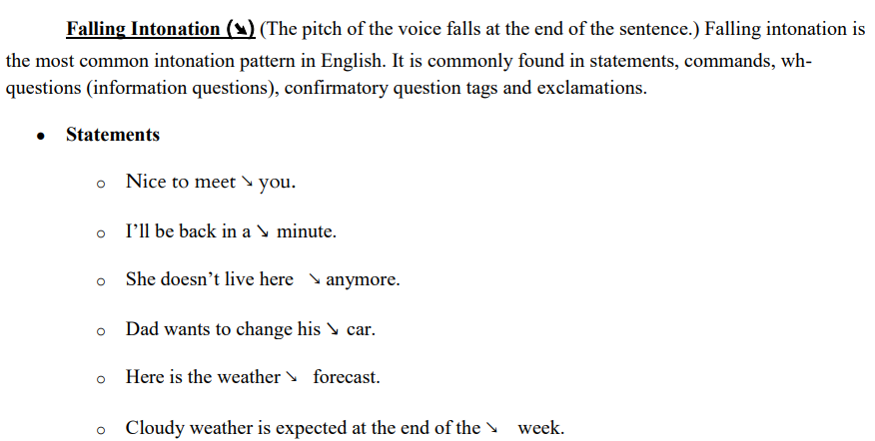

Slide 29
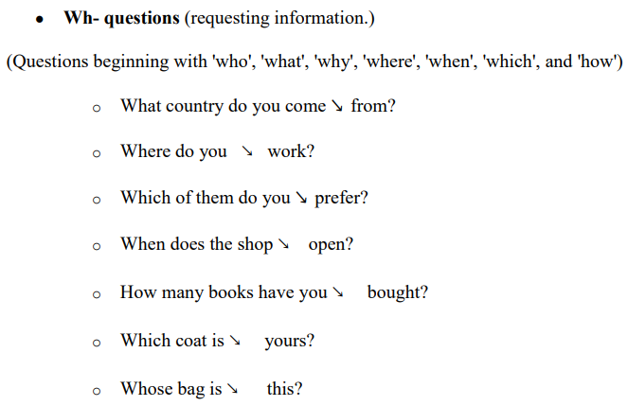

Slide 30
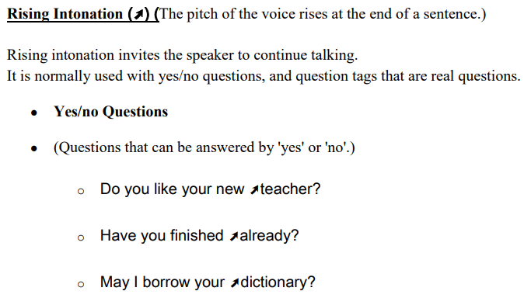

Slide 31
